Slide 1
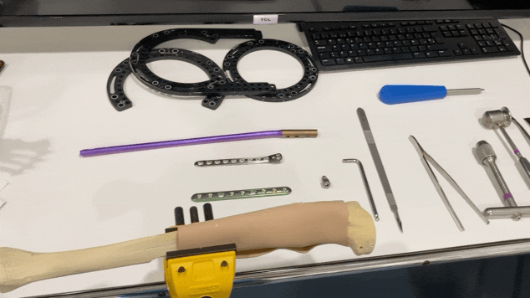

1
NURSE´S/SURGEON´S POINT OF VIEW
SURGEONS/NURSE VIEW IS TRANSSMITTED LIVE TO ASSISTANT

Slide 2
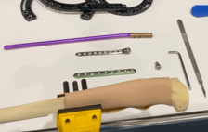

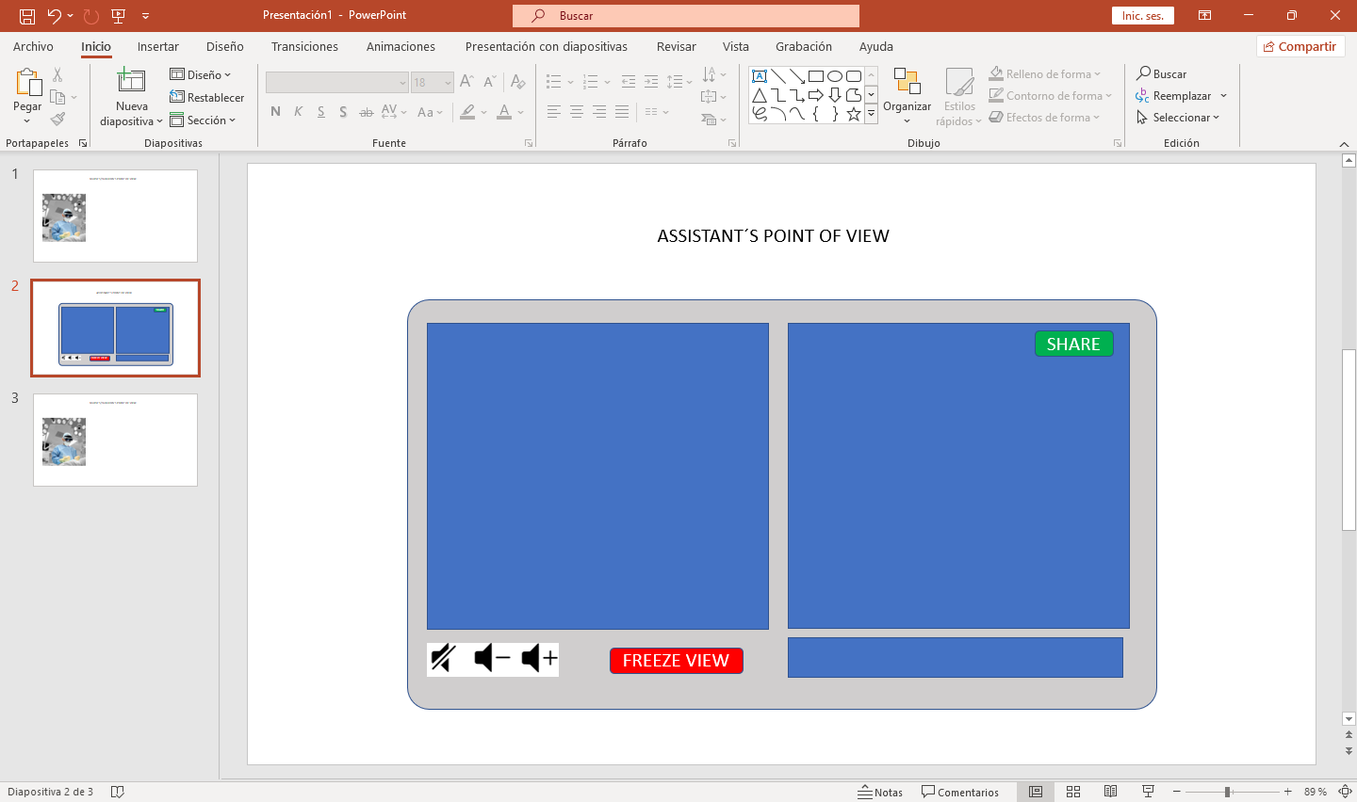
2
ASSISTANT´S POINT OF VIEW
Drawing Tools
SHARE
Pauses the video and sends image to right screen
Show in left screen images (xrays)
Ppt slides, animations, etc… and share with surgeon
FREEZE VIEW
BROWSE FILES
ASSISTANT FREEZES THE VIEW. THIS APPEARS ON LEFT SCREEN. ASSISTANT CAN DRAW INSTRUCTIONS ON IT AND SHARE

Slide 3
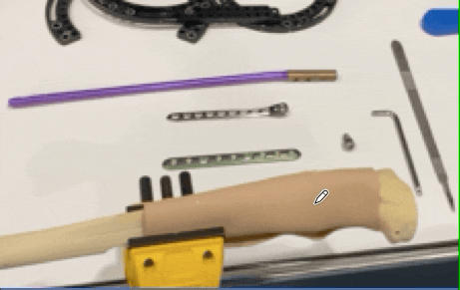
3
ASSISTANT´S POINT OF VIEW
SHARE
FREEZE VIEW
BROWSE FILES
DRAWING AND SHARING INSTRUCTIONS

Slide 4
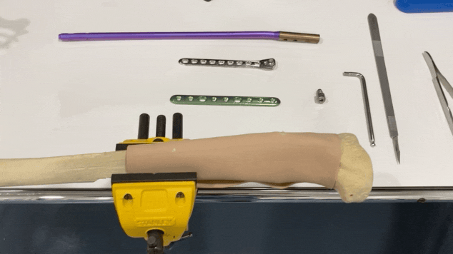
4
NURSE´S/SURGEON´S POINT OF VIEW
Dr. Rueger (Zurich)
Dr. Narbona (Madrid)
SURGEON OR NURSE SEES AN AR CANVAS SHOWING THE INSTRUCTIONS SENT BY ASSISTANT
ASSISTANT CHECKS SURGEON/NURSE PROGRESS

